Slide 1

YABA COLLEGE OF TECHNOLOGY STUDENTS INSIGHT FOR THE YEAR 2017-2023
HIGHER INSTITUTION SECTOR
PRESENTED BY: Data analytics group
DATE: AUGUST, 2025.

Slide 2
OBJECTIVE:
This report provides a comprehensive overview of student academic performance, admission trends, and graduation outcomes for Yabatech over the period 2017-2023.
The goal is to equip decision-makers with clear insights for strategic academic and institutional growth.
KEY QUESTONS ANSWERED:
How many students were admitted and graduated between 2017-2023?
What is the average CGPA across all students?
What is the overall graduation rate?
What are the admission trends?
Which departments have the highest or lowest graduation rates?

Slide 3
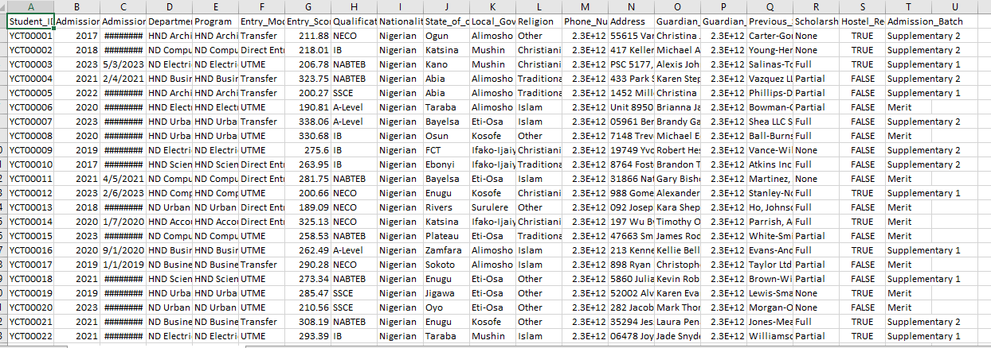
ADMISSION SEMI-STRUCTURED DATA

Slide 4
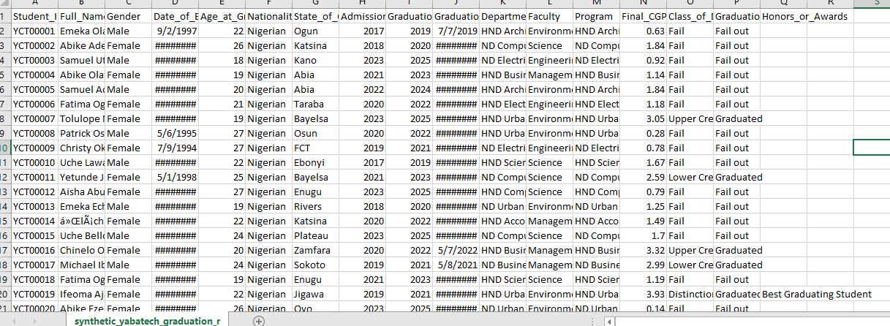
GRADUATION SEMI- STRUCTURED DATA

Slide 5
DATA SOURCES: synthetic Yabatech datasets (csv file)
DATA TYPE: Semi-structured data
TOOLS: Microsoft Excel and Microsoft Power BI
DATA CLEANING: Auto fitting, data types, find and replace, cell formatting, renamed columns, merge query, and creating columns
PERIOD COVERED: 2017-2023

Slide 6
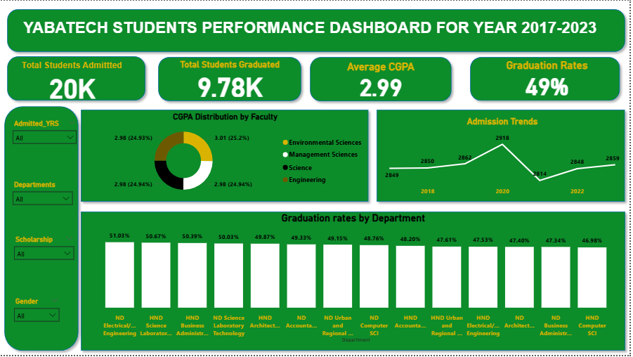
DASHBOARD OVERVIEW

Slide 7
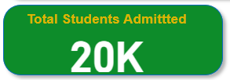
ADMISSION STATUS FOR 7 YEARS
The total number of new students enrolled in yabatech between 2017-2023.
It shows the institution’s attractiveness and ability to recruit students.

Slide 8
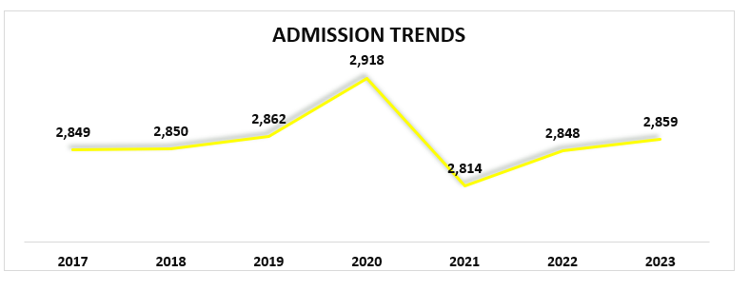
ADMISSION TRENDS ANALYSIS
It tracks how the students enrollment number changed each year.
A peak in 2020, According to vanguardngr.com. jamb reported that over 1.9 million candidates registered to write the 2020 UTME and over 1.3 million candidates scored above 120. It was the highest in jamb history. This was made known by Dr fabian Benjamin, the board’s head of media and information, more high performing candidates in 2020 translated to broader eligibility and enabling institutions including Yabatech to admit more students.
Followed by a sharp drop in 2021, Decline in high UTME scorers the number of candidates scoring above 180 and 189 marks were 90,688. This drastic decline had a ripple effects on admission rates and institutions including Yabatech were affected.

Slide 9

GRADUATION STATUS FOR 7 YEARS
Total number of students who completed their programs and officially graduated during the 2017-2023 period.
It reflects the institution’s success in guiding students from admission to completion.
Over 10k students did not graduate due to withdrawal, financial issues, personal issues, and academic failure

Slide 10
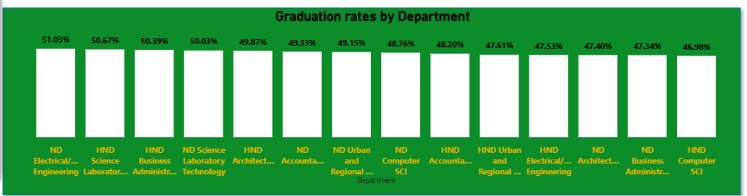
GRADUATION RATES OVERVIEW
The graduation rate shows the percentage of students who successfully completed their program out of all who enrolled in each department
ND Electrical/electronics has the highest rates just over half of students admitted in the department graduated within the study period due to strong academy system and teaching methods.
HND computer science has the lowest rate, less than half of the students completed their program. Reasons are due to students dropping out, difficult courses and workload.

Slide 11

OVERALL GRADUATION RATES
The percentage of students who successfully graduated out of those admitted in the same period
Calculated as graduated students/admitted students *100
49% rates means over half of the students did not graduate within the period, due to withdrawal, financial issues, personal issues, and academic failure.

Slide 12
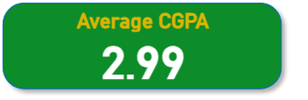
CGPA STATUS FOR 7 YEARS
The average CGPA of all students across the 7 years, graded on a 4.0 scale in the institution education system
It indicates the general academic performance level of students.
3.50-4.00 – Distinction ( 2,461 students )
3.00-3.49 – Upper credit ( 2,517 students)
2.50-2.99 – Lower credit ( 2,427 students)
2.00-2.49 – Pass ( 2,594 students)
<2.00 – Fail (10,001 students ).

Slide 13
RECOMMENDATIONS
To Enhance admission strategies: Strengthen the institution brand visibility through alumni success stories, highlighting graduates who have excelled in industry or academia, introduce in-demand and market-relevant courses such as data analytics, web design, ai and machine learning, etc.
Renovation/Expansion: To sustain yabatech legacy as a leading institution, immediate investments in renovation and expansion is necessary. Upgrading of lecture halls, laboratories, and hostels. Renovating yabatech is not just buildings, but creating an environment that improves learning and meets the needs of our growing population.
Boost student retention and graduation rates: In other to address the challenges of low graduation rates and uneven academic performance, the institution should support students through early intervention and mentorships, enhance teaching effectiveness with modern methods, the college should as well balance lecture timetable by reducing unnecessary daily classes and introducing free periods that allow for self-study, research, and personal developments.

Slide 14
THANK YOU !!!!
QUESTIONS AND FEEDBACKS ARE WELCOME
DETAILS: Data Analytics group
Facilitator: MR. Israel Ogundele

